Slide 1
Applied Cryptography hash pointer, blockchain, Merkle tree, public key as identities,
Goofycoin, Scroogecoin
LiangFeng Zhang
zhanglf@shanghaitech.edu.cn
ShanghaiTech

Slide 2
Cryptocurrency and Blockchain
Fiat currency:
Central banks control the money supply
Add anti-counterfeiting features to physical currency
Technological: raise the bar for an attacker
Law enforcement: stop people from breaking the rules of the system.
Problems in currency: supply and prevent cheating
Cryptocurrency: Bitcoin, Ether, …
prevent people from tampering with the state of the system and from equivocating (e.g., double spending)
the security rules need to be enforced purely technologically and without relying on a central authority
Blockchain: The underlying data structure of a cryptocurrency.
Build with hash pointers

Slide 3
Hash Pointer
Hash pointer: A pointer to where some information is stored together with a cryptographic hash of the information
Regular pointer: allows you to retrieve info.
Hash pointer: retrieve info. + verify that the info. hasn’t been changed
Application: build all kinds of data structures
Data structures that use pointers: a linked list or a binary search tree
Implement it with hash pointers instead of ordinary pointers

Slide 4
Blockchain
Blockchain: A linked list using hash pointers.
Regular linked list: a series of blocks; each block=data+ a pointer to the previous block in the list
Blockchain: the pointer will be replaced with a hash pointer.
The pointer tells us where the previous block was
It also contains a digest of that block’s value
allows us to verify that the value hasn’t been changed

Slide 5
Application of Blockchain
Tamper-evident log: a log data structure that stores data and allows us to append data to the end of the log
if somebody alters an earlier item in the log, we can detect the change.
The adversary cannot tamper with the head of the list.
genesis block: the first block on the chain

Slide 6
Merkle Tree
Merkle Tree: A binary tree with hash pointers
Building a Merkle tree in the following way:
Leaves of the tree: blocks containing data
Group the data items into pairs of two
For each pair we build a data structure that has two hash pointers
Group the hash pointers into groups of two,
Compute the hash of each pair
Continue doing this until we reach a single block
Merkle root: the root of the tree
The data items
in Bitcoin are
transactions.

Slide 7
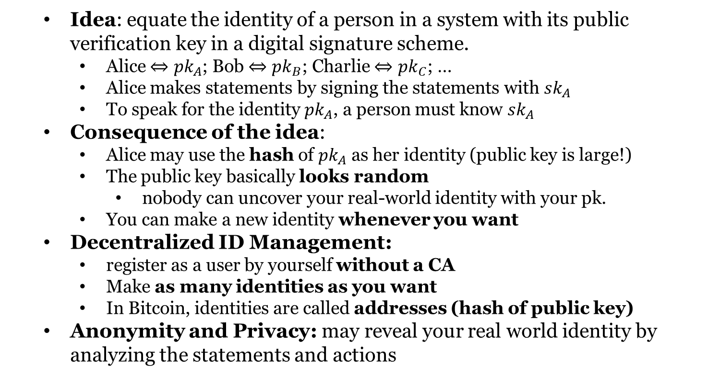
Public Key as Identities
Idea: equate the identity of a person in a system with its public verification key in a digital signature scheme.
Alice $⇔pk_{A}$; Bob $⇔pk_{B}$; Charlie $⇔pk_{C}$; …
Alice makes statements by signing the statements with $sk_{A}$
To speak for the identity $pk_{A}$, a person must know $sk_{A}$
Consequence of the idea:
Alice may use the hash of $pk_{A}$ as her identity (public key is large!)
The public key basically looks random
nobody can uncover your real-world identity with your pk.
You can make a new identity whenever you want
Decentralized ID Management:
register as a user by yourself without a CA
Make as many identities as you want
In Bitcoin, identities are called addresses (hash of public key)
Anonymity and Privacy: may reveal your real world identity by analyzing the statements and actions

Slide 9
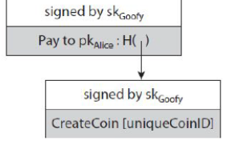
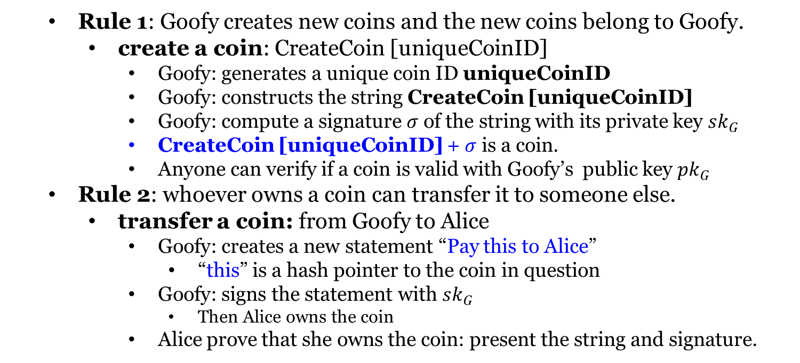
Goofycoin
Rule 1: Goofy creates new coins and the new coins belong to Goofy.
create a coin: CreateCoin [uniqueCoinID]
Goofy: generates a unique coin ID uniqueCoinID
Goofy: constructs the string CreateCoin [uniqueCoinID]
Goofy: compute a signature $σ$ of the string with its private key $sk_{G}$
CreateCoin [uniqueCoinID] + $σ$ is a coin.
Anyone can verify if a coin is valid with Goofy’s public key $pk_{G}$
Rule 2: whoever owns a coin can transfer it to someone else.
transfer a coin: from Goofy to Alice
Goofy: creates a new statement “Pay this to Alice”
“this” is a hash pointer to the coin in question
Goofy: signs the statement with $sk_{G}$
Then Alice owns the coin
Alice prove that she owns the coin: present the string and signature.

Slide 10
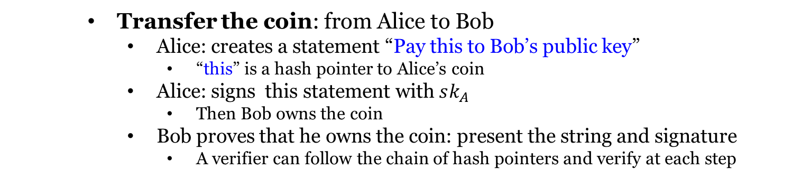
Goofycoin
Transfer the coin: from Alice to Bob
Alice: creates a statement “Pay this to Bob’s public key”
“this” is a hash pointer to Alice’s coin
Alice: signs this statement with $sk_{A}$
Then Bob owns the coin
Bob proves that he owns the coin: present the string and signature
A verifier can follow the chain of hash pointers and verify at each step

Slide 11
Goofycoin
Double-spending attack: Spend the same coin twice
Alice transfer her coin by sending her signed statement to Bob
Alice didn’t tell anyone else about this transfer
Alice sends a signed statement that pays the same coin to Charlie.
Bob and Charlie both claim to be the owner of that coin.
Double-spending attack is one of the key problems that any cryptocurrency has to solve.

Slide 13
Scroogecoin
Scrooge publishes an append-only ledger containing all TX history
Any data written to this ledger will remain forever in the ledger
A TX must be written in the ledger before it is accepted
The history of coins will be publicly documented
Each block: ID of TX, TX contents, a hash pointer to the previous block
A TX counts iff it is in the block chain signed by Scrooge.
Scrooge doesn’t endorse a TX that double spends a coin.
A TX is endorsed by Scrooge? Checking signature

Slide 14
Scroogecoin
In Scroogecoin, there are two kinds of transactions.
CreateCoins: valid if it is signed by Scrooge
PayCoins: Consumes coins; creates new coins of same total value
The PayCoins TX is valid iff
The consumed coins are valid (created in previous TXs)
The consumed coins have not already been consumed earlier
Out coins = in coins
It is validly signed by the owners of all consumed coins

Slide 15
Scroogecoin
If PayCoins transaction is valid
Scrooge will accept it
Scrooge write it into the ledger by appending it to the blockchain
everyone can see that this TX has happened.
Prevent double spending: People can determine if
the coins are valid
all TXs are valid
every coin is spent only once
The centralization in Scroogecoin:
Scrooge stop endorsing TXs from some users?
coins become unspendable
cryptocurrencies with a CA largely failed to take off in practice
Get rid of Scrooge? Need Distributed Consensus
users need to be able to assign IDs in a decentralized way
the minting of new coins needs to be decentralized
users can agree on which TXs are valid, have actually occurred
users can agree on a single published blockchain as the TX history

Slide 17
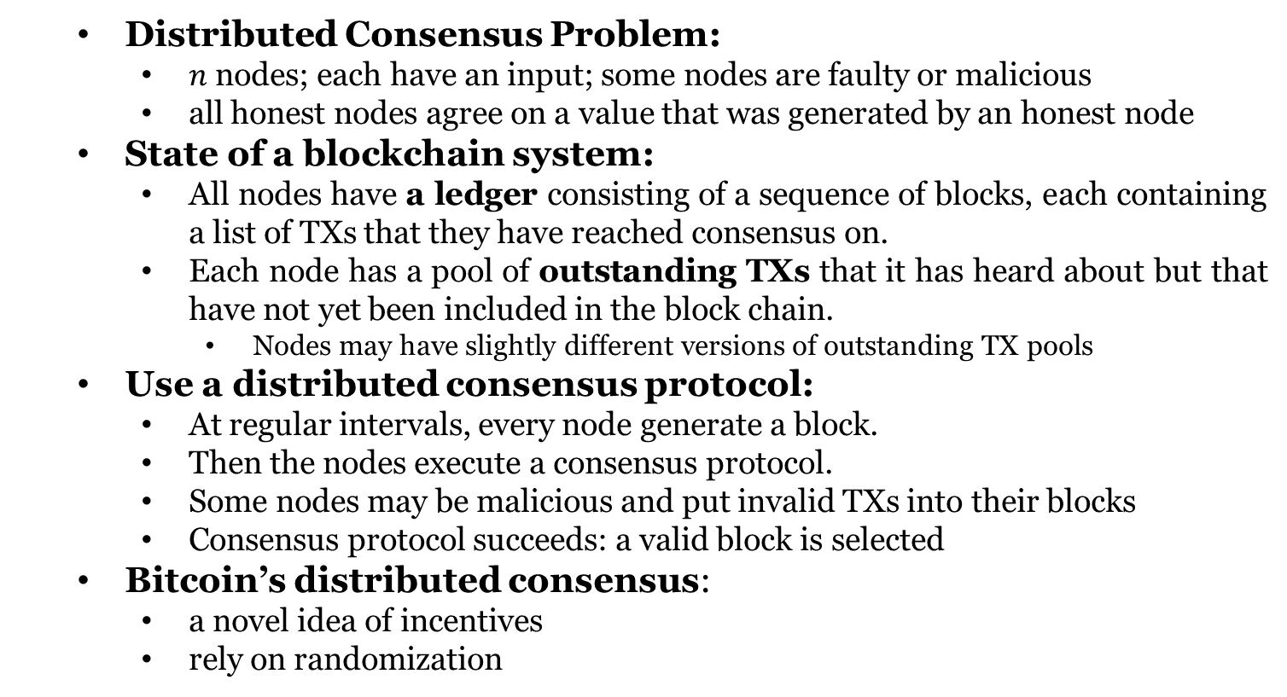
Distributed Consensus
Distributed Consensus Problem:
$n$ nodes; each have an input; some nodes are faulty or malicious
all honest nodes agree on a value that was generated by an honest node
State of a blockchain system:
All nodes have a ledger consisting of a sequence of blocks, each containing a list of TXs that they have reached consensus on.
Each node has a pool of outstanding TXs that it has heard about but that have not yet been included in the block chain.
Nodes may have slightly different versions of outstanding TX pools
Use a distributed consensus protocol:
At regular intervals, every node generate a block.
Then the nodes execute a consensus protocol.
Some nodes may be malicious and put invalid TXs into their blocks
Consensus protocol succeeds: a valid block is selected
Bitcoin’s distributed consensus:
a novel idea of incentives
rely on randomization

Slide 18
Idea of Bitcoin Consensus
Bitcoin: nodes do not have persistent, long-term identities; no CA
Sybil attack: An adversary controls many copies of nodes
Assumptions:
It is possible to pick a random node from the Bitcoin network
The Sybils obtain only 1 token.
Bitcoin’s consensus: under the two assumptions,
New TXs are broadcast to all nodes.
Each node collects new TXs into a block.
In each round, a random node gets to broadcast its block.
The block is accepted iff all TXs in it are valid (unspent, valid signatures).
Nodes accept the block by including its hash in the next block they create.

